Slide 1


COLLEGE BOOKS REPOSITORY SYSTEM
PRESENTED BY :
SHOAIB CHAUDHRY

Slide 2


WHAT IS COLLEGE BOOKS REPOSITORY SYSTEM ?
Students often have to run to bookshops or after their seniors/friends to procure books and other study material. The project aims at associating and representing academic material from all the available resources in an organised manner.

Slide 3
INTRODUCTION OF JAVA
JAVA IS A PROGRAMMING LANGUAGE.
IT IS A PLATEFORM INDEPENDENCE LANGUAGE
1990------ GREEN PROJECT
1991------- OAK
1995------ JAVA (COFFY EXPORT)
1996------ JDK 1.0

Slide 4
Features of proposed system:
1) The proposed system is less time consuming and more efficient.
2) Results will be displayed in a very short span of time just because of automated system.
3) Users have an option of saving money by borrowing a book instead of buying it.
4) The proposed system is secure because the users has limited access to the database
5) The books and user information are stored in secure database which is handled by an administrator and backup can be thus created for future use.

Slide 5
Functional components of the project
1. The system have appropriate login facility. Relevant options like change password and updating profile etc.
2. The system should allow administrator to control all the activities hence identify the roles and accessibility of other users.
3. The user should have the facility to add/delete new books and eBooks as and when needed.

Slide 6
Functional components of the project
4. The user adding a book has an option of providing the book on sale or just for borrowing.
5. The user adding a book can also recommend his/her book to other users.
6. The user can search for books by enabling filters such as publisher, author, course or semester.
7. The owner is provided with an option of either accepting or rejecting the request of an individual for a particular book.

Slide 7
BENEFITS AND ADVANTAGES OF BOOK REPOSITORY SYSTEM
It decreases time consumption of students.
Increases options of books for the students.
Identify the importance of books by recommend option.
Helping students who need the books just for borrowing.
Everyone is clear about how to get an instant access to the books.

Slide 8
BENEFITS AND ADVANTAGES OF BOOK REPOSITORY SYSTEM
Allowing seller to earn some money by selling his/her books.
Adding an option of eBooks helps student in case of emergency needs.
Introduce users to meet identified needs
Displaying instant results in a very short span due to addition of filters.
Securing the system by limiting users to access the database.

Slide 9
MODULES OF THE PROJECT
0th LEVEL
0th LEVEL
Home
BORROWER
Login
BOOK
REPOSITORY
SYSTEM
BUYER
Sign Up
Contact Us
OWNER
USER
About Us
level
BORROWER
Home
Login
BOOK
REPOSITORY
SYSTEM
BUYER
Sign Up
Contact Us
OWNER
About Us
USER

Slide 10
MODULES OF THE PROJECT
1st LEVEL
Home Page
User
Home
Login
Sign Up
About Us
Contact Us

Slide 11
MODULES OF THE PROJECT
EBook
By User
Recommended
Status
Semester
Course
Program
Publisher
Author

Slide 12
DFD: DATA FLOW DIAGRAMS:
0 level :
Id, password query Responses of Queries
USER
LOGIN AS ADMIN
ENTER THE ADMIN MODULE

Slide 13
DFD: DATA FLOW DIAGRAMS:
Context level :
Id, password &query Responses of Queries
USER
USER

Slide 14
REQUIREMENTS OF THE PROJECT :
SPECIFIC REQUIREMENT:
SOFTWARE SPECIFICATION
WEB SERVER : Glassfish 6.0 or Apache Tomcat 6.0
LANGUAGE : Core Java, Advance Java (JDK-6.0)
DATABASE : MS ACCESS, SQL ORACLE
BROWSER : Internet Explorer, Firefox etc.
SCRIPTING LANGUAGE : HTML, JAVA Script

Slide 15
SPECIFIC REQUIREMENT:
KEYBOARD | STANDARD
MOUSE | STANDARD
MONITOR | VGA or XVGA
CD-ROM | 4X or above

Slide 16
PROCESS REQUREMENTS
PROCESSOR | Intel Dual Core or Higher
RAM | 1 GB or above
HARD DISK | 2 GB or above

Slide 17
CONTROL REQUREMENTS
OPERATING SYSTEMS | WINDOW XP or Higher

Slide 18
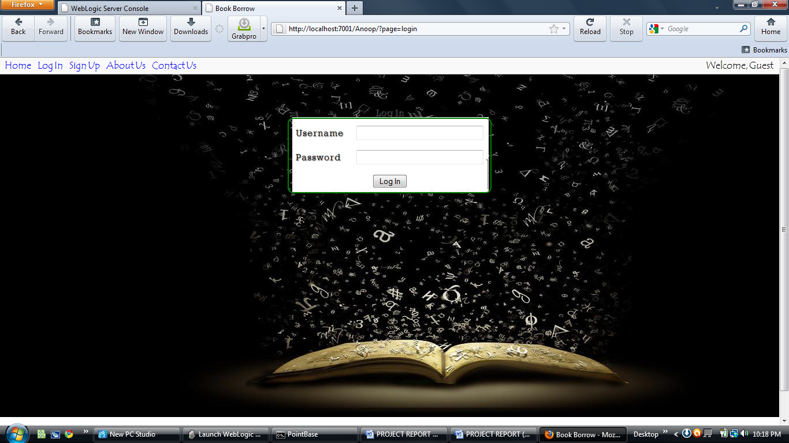
SCREENSHOTS :
ADMIN LOGIN :

Slide 19
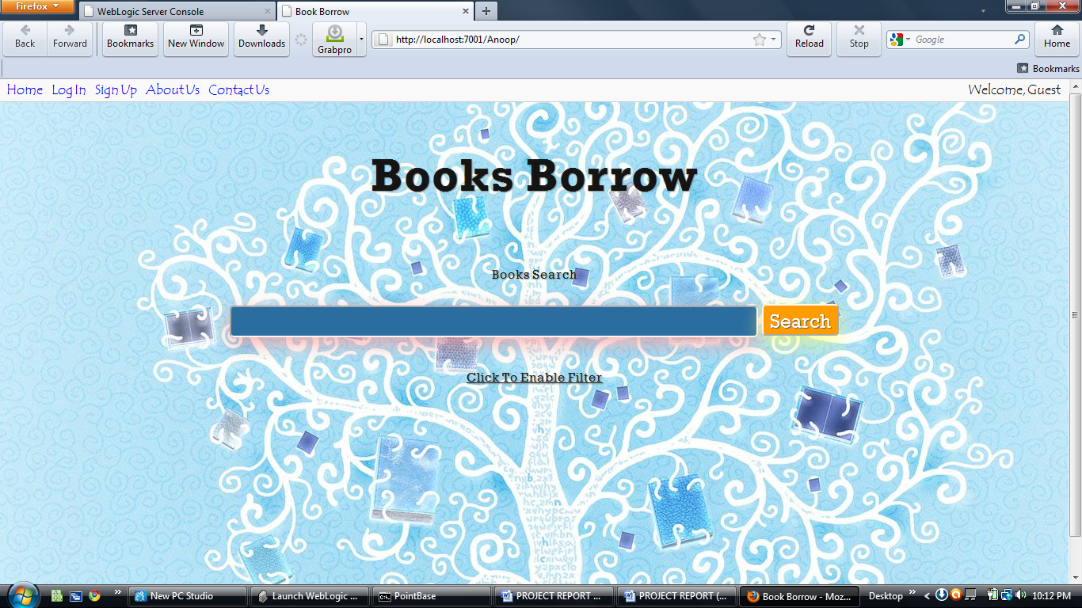
SCREENSHOTS :
Admin Home Page:

Slide 20
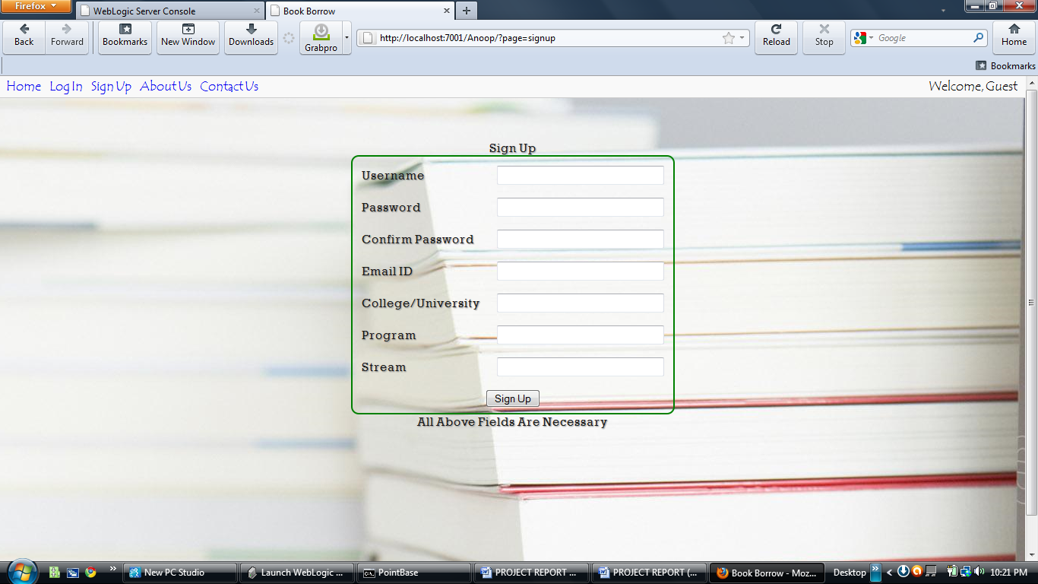
SCREENSHOTS :
Customer Details in Admin Page:

Slide 21
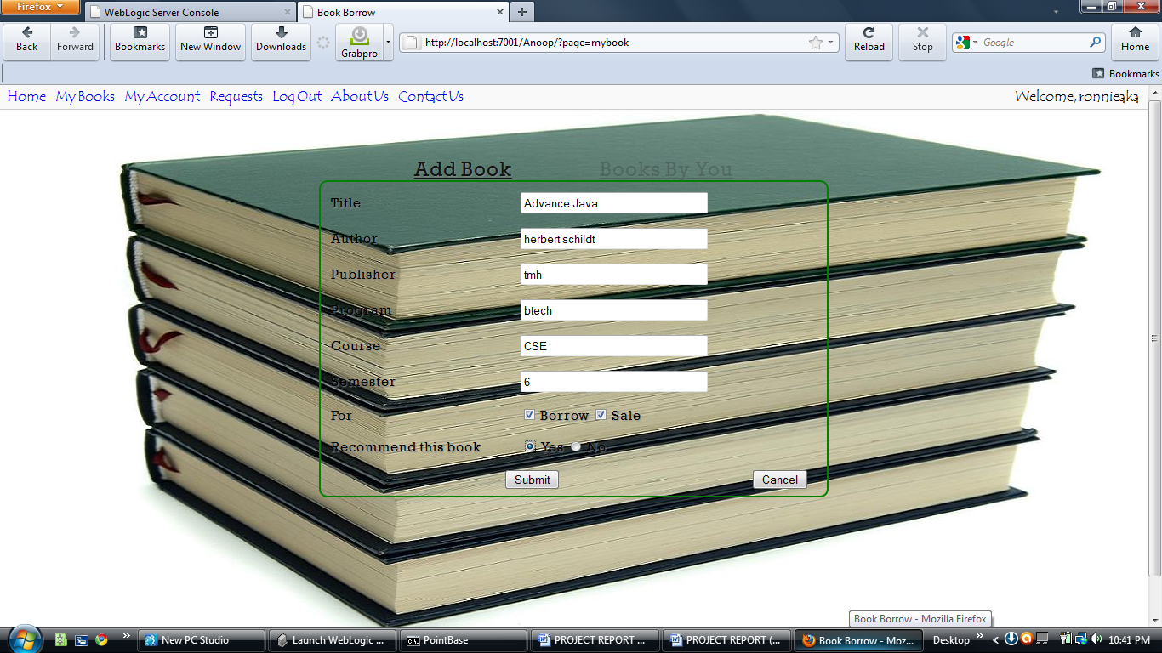
SCREENSHOTS :
Add New Customer In admin page:

Slide 22
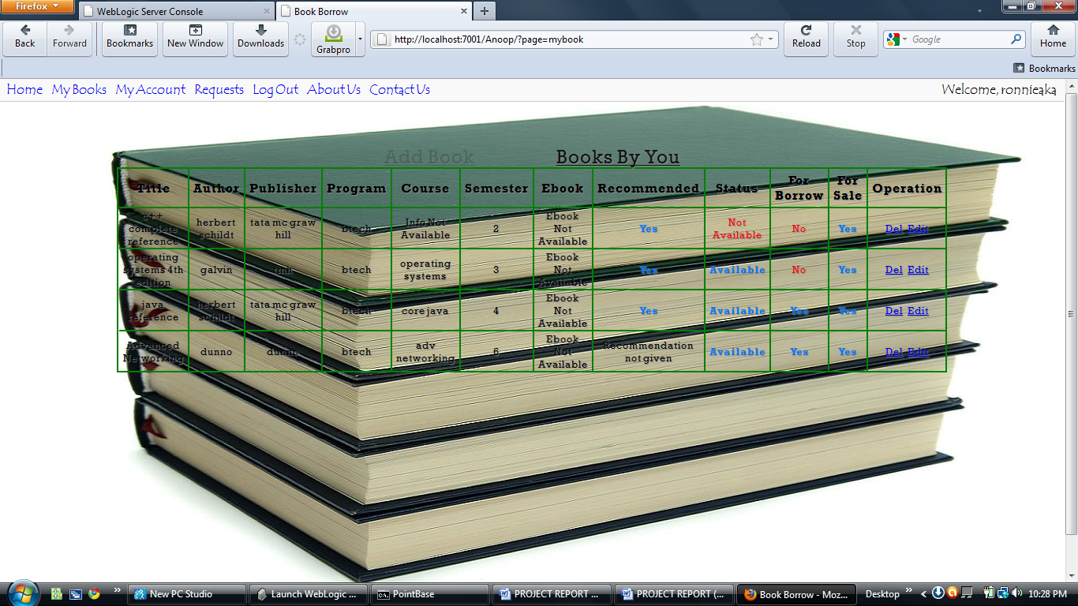
SCREENSHOTS :
BOOKS BY BUYER:

Slide 23
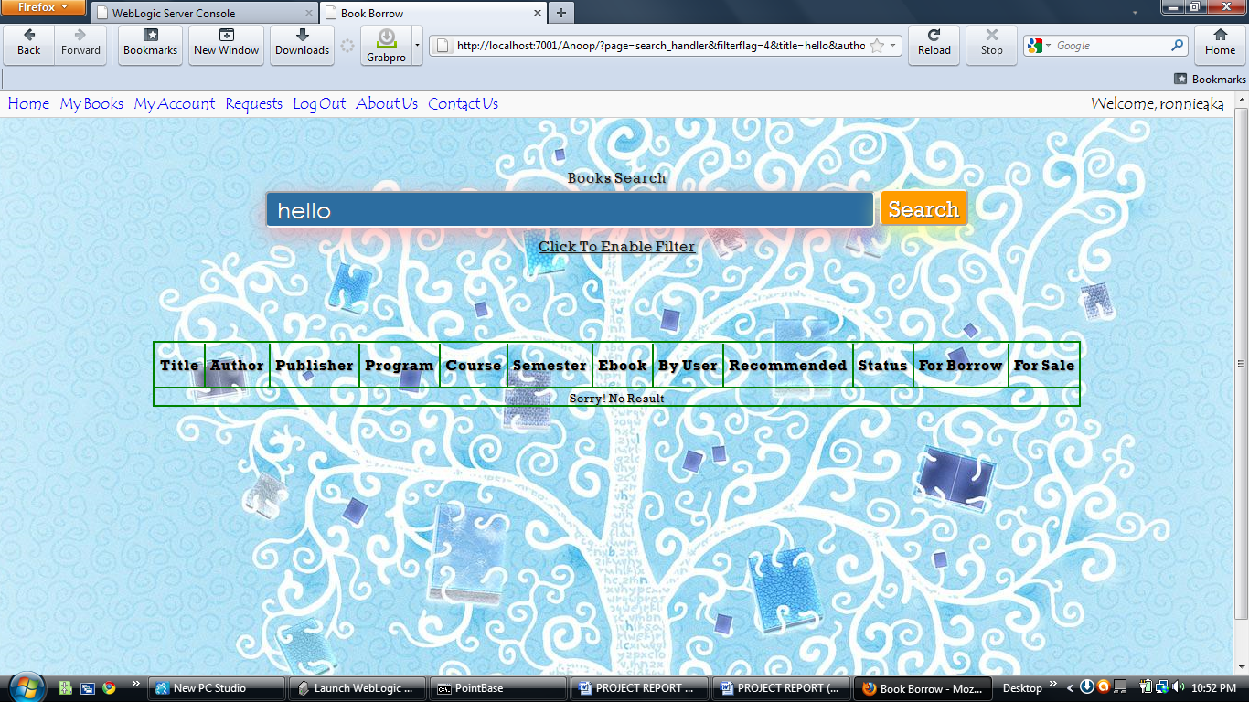
SCREENSHOTS :
SORRY NO RESULT DISPLAYED:

Slide 24
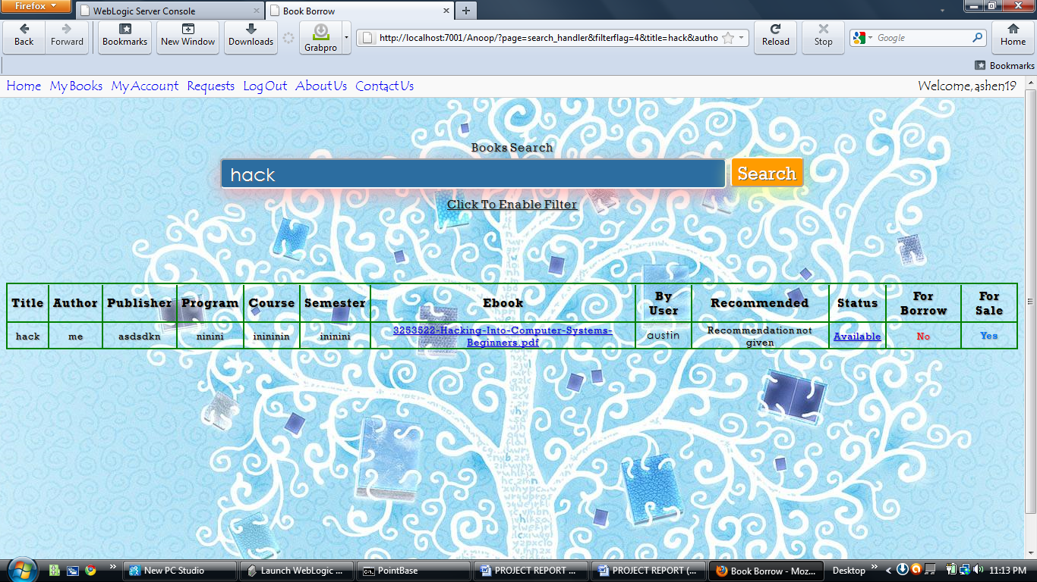
SCREENSHOTS :
SEARCH SUCCESSFUL:

Slide 25
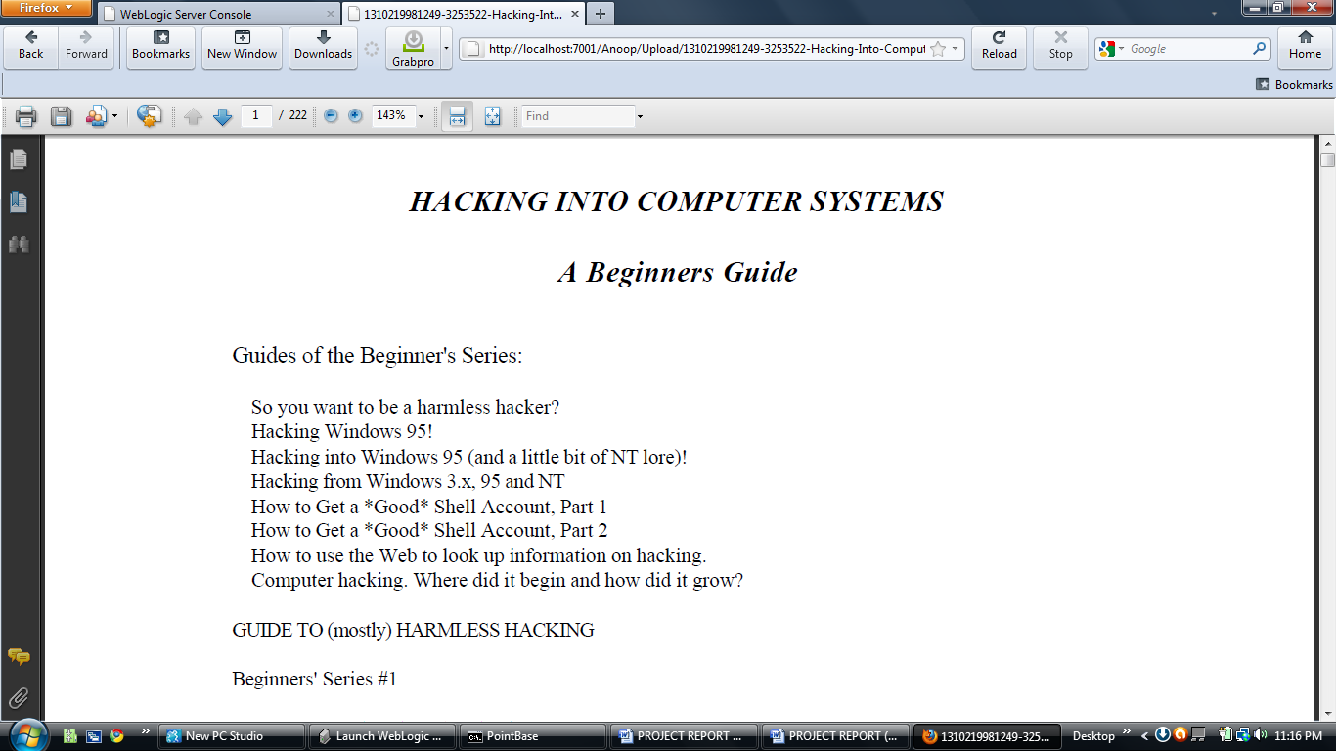
SCREENSHOTS :
HAKING INTO COMPUTER SYSTEM:

Slide 26
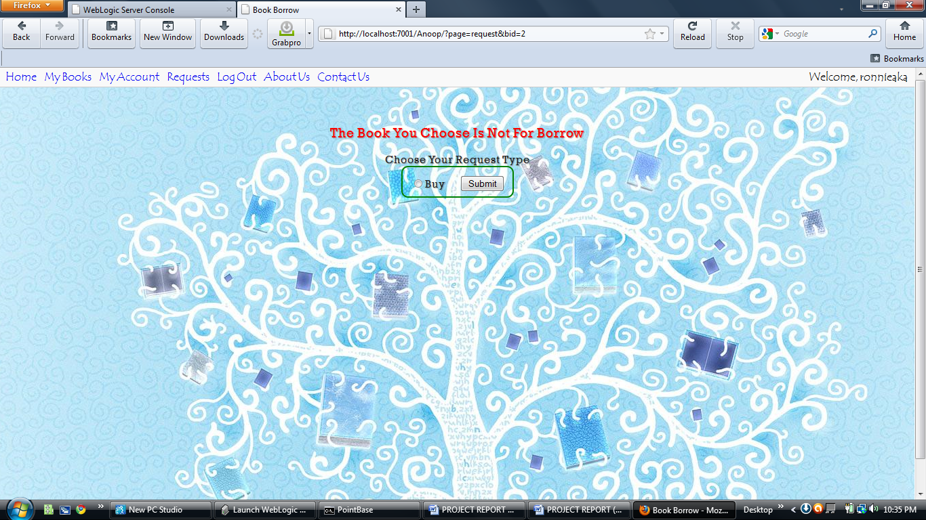
SCREENSHOTS :
THE BOOK IS NOT BORROWED:

Slide 27
CONCLUSION :
The result of the COLLEGE BOOK REPOSITORY SYSTEM is that it supports many solved complaints from admin and the individual users or the end-users with unique interface, through which the employee problems are solved within given time and it shows efficiency in the internal messaging system and results in accurate task scheduling system and this can be run with the minimal administration.

Slide 28

QUERIES ?

Slide 29
THANKS

